Slide 1
CSD1400
Week 8 Milestone
Pitch Presentation
Production Plan

Slide 2

Pitch Presentation

Slide 3
Pitch Presentation
Week 8
During Lab time

Slide 4
Pitch Presentation
Refer to a future MS Teams announcement for info:
Venue of Presentation
When each team will present
Done in person

Slide 5
Pitch Presentation
Each team has 5 Minutes to present
Each member must present for at least 1 minute

Slide 6
Presentation Platform (in person)
Using your own laptop, connected to the projector system
Many options for materials:
Powerpoint slides
Videos
Etc
DO NOT rely on the Wi-Fi of the lecture theatre
Make sure you have everything you need already on your hard disk

Slide 7
Presentation Platform (online)
Share you desktop via MS Teams. Team to turn on cameras.
Many options for materials:
Powerpoint slides
Videos
Etc
Make sure anyone is capable of presenting

Slide 8
Dress Code
Dress for job interview
Dress for meeting with an investor
Dress as a team

Slide 9
Pitch - Grading
Product Vision
Feasibility
Presentation

Slide 10
Product Vision

Slide 11
Product Vision
Clear idea of your product
Unique Selling Point (USP)

Slide 12

Unique Selling Point
It is difficult to create something totally new and unique.

Slide 13
Unique Selling Point
Many products today are very similar to each other
Some even seem to be blatant copies
Nonetheless you must try

Slide 14
Unique Selling Point
Inspiration
Solution to pain points
Introducing new systems and processes
Themes & Narratives
Past experiences

Slide 15

Unique Selling Point
Normally we draw inspiration from multiple sources

Slide 16
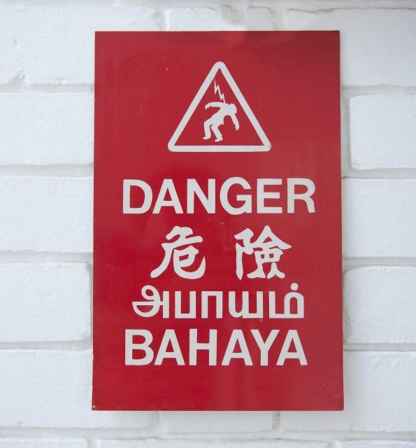
WARNING!
Tendency to increase “Breadth” of the product for uniqueness
Feature Creep
Hard to cut features in a crunch
Difficult to maintain a clear goal and direction

Slide 17
Unique Selling Point
Keep it as simple as possible
Example : Sneeze
https://www.youtube.com/watch?v=aFPwfEX2Vl0
Less is more
Its ok to start with multiple features, but know what to focus on

Slide 18

Feasibility

Slide 19
Scope
The scale of features required to realize your product
Quantity
Complexity
The Scope of your project will be scrutinized
Over Scope – Project too ambitious, need to cut features
Under Scope – Not enough work/effort for the team
Note that you have a finite amount of time for your project

Slide 20
Scope
Reflect on the Solo Projects
Better analyze the difficulty of tasks
Better predict the amount of time and effort required
Be more realistic on the time you have
Techniques you have at your disposal

Slide 21
Scope Discussion
Better analyze the difficulty of tasks
Which tasks were the
Easiest
Hardest
In between
What were your expectations of these tasks before you started on them?

Slide 22
Scope Discussion
Better predict the amount of time and effort required
What was your estimate on the time needed for the task to be done?
How much time did it actually take you?
What did you need to get it done?

Slide 23
Scope Discussion
Be more realistic on the time you have
How much time do you spend on other modules
How much time do you really have for this class (outside of lab time)

Slide 24
Scope Discussion
Techniques you have at your disposal
Which techniques are you sure about?
Which techniques need more work? How much more work?

Slide 25
Reminder
Focus of this class is programming
Bulk of your time should not be spent on art
Penalties levied against those who did not code enough

Slide 26
Reminder
Keep visuals as simple as possible
Use basic shapes as much as possible
Animate with transformations rather than art assets
Particle systems instead of drawn visual effects

Slide 27
Delivery Plan
Refer to production planning slides for overall plan
Will need to see milestones for key tasks and systems in presentation

Slide 28
Delivery Plan
Reflect on the Solo Projects
Week | Goal
1 | Render shape with texture or colour
2 | Render multiple shapes, multiple colours Button functionality, input detection, states, movement
3 | Render grid Grid states and logic
4 | Pause and Play state

Slide 29
Delivery Plan
Reflect on the Solo Projects
Week | Goal
1 | Render shape with texture or colour
Begin with the most basic of functionalities

Slide 30
Delivery Plan
Reflect on the Solo Projects
Week | Goal
1 | Render a single shape, single colour Detect and process input
2 | Render multiple shapes, multiple colours Button functionality, input detection, states, movement
Build upon your fundamentals. Extend basic functionalities.

Slide 31
Question
Should/Could we have swapped goals for weeks 3 and 4?
Week | Goal
1 | Render shape with texture or colour
2 | Render multiple shapes, multiple colours Button functionality, input detection, states, movement
3 | Render grid Grid states and logic
4 | Pause and Play state

Slide 32
Answer
What is the core of this “game”?
Cellular automata that simulates life and death
Pause and Play, clicking and editing, additional features
More important to get the simulation working first.

Slide 33
Question
Car Select Game
What was the most important feature? (USP)
What was the sequence of tasks you did to finish it?
What was required for the grade?
Always important to read the requirements

Slide 34
Delivery Plan (Summary)
Provide a brief list of milestones and goals for those milestones
Weekly breakdown will be good
For weeks 8 - 13
Full details of weekly tasks, should be kept for the production document. NOT IN YOUR PITCH PRESENTATION

Slide 35
Delivery Plan (Summary)
Keep in mind
Playtesting of your game to be conducted by end of Week 12
Week 13 should just be for bug fixing and preparing for submission.

Slide 36

Risks & Mitigations

Slide 37
Risks and Mitigations
With everything we do there are certain risks involved
Risk/Reward
A mitigation plan is required for risks identified
Mitigation plan – a fallback that can be executed with little to no risk to execute

Slide 38
Risk and Mitigations (Example)
A Star Pathfinding for better Enemy AI
Benefits:
Enemy able to navigate terrain
Find shortest path to target
Increases tension in game thus making it more engaging

Slide 39
Risk and Mitigations (Example)
A Star Pathfinding for better Enemy AI
Risks:
Requires knowledge of graph implementation
Requires understanding of open/close list
Requires understanding of heuristic and true cost value

Slide 40
Risk and Mitigations (Example)
A Star Pathfinding for better Enemy AI
Possible Mitigations
Enemy only pursues target within line of sight
Enemy only pursues target within a certain distance
Enemy is a ghost that can pass through walls?
Note that Mitigations should still be in line with your product vision.

Slide 41
Risk and Mitigations
List
List the biggest risks in your presentation
Plan
Have a mitigation plan in place
“If by Day X we cannot accomplish this, we will execute this mitigation plan within Y days”
Prudent
Mitigation plans need to be feasible within the time you have.

Slide 42
Things that are !RISKS (not risks)
Not Enough Time
The time you have is limited and stated clearly at the start
There is a limit to you “making time”
This is why planning and scoping are important

Slide 43
Things that are !RISKS (not risks)
Not Enough Technical Skills/Experience
What you have done before, you can do again
For new features, do your research
For new features, the risk is of the feature

Slide 44
Things that are !RISKS (not risks)
Not Enough Art/ No Artists
This is known at the start, a limitation not risk
Original plan should already work around this

Slide 45
Conclusion

Slide 46
Be Prepared
More than one laptop with presentation (in case)
Refer heavily to the Pitch Presentation Rubrics on Moodle
Be focused on what’s important
Rehearse

Slide 47
Submissions (one per team)
Presentation Materials
Naming Convention
<teamname>_Pitch.<relevant file extension>
You may add numbers or other names if you have more than one material to submit
<teamname>_Pitch_<number/name>.<relevant file extension>
Submit on Moodle, by Week 8 Tuesday by 9am
Regardless of when your team is presenting

Slide 48
Submissions (one per team)
Production Plan
Filled up Production Plan, get the template from Moodle
Submit on Moodle by Week 8 Sunday before Midnight
Naming Convention
<TeamName>_ProductionPlan.xlsx

